Slide 1




Data Science Curricula at the University of Washington
Bill Howe, PhD
Director of Research, Scalable Data Analytics
University of Washington eScience Institute

Slide 2


Slide 3
http://escience.washington.edu

Slide 4
The University of Washington eScience Institute
Rationale
The exponential increase in sensors is transitioning all fields of science and engineering from data-poor to data-rich
Techniques and technologies include
Sensors and sensor networks, databases, data mining, machine learning, visualization, cluster/cloud computing
If these techniques and technologies are not widely available and widely practiced, UW will cease to be competitive
Mission
Help position the University of Washington at the forefront of research both in modern eScience techniques and technologies, and in the fields that depend upon them
Strategy
Bootstrap a cadre of Research Scientists
Add faculty in key fields
Build out a “consultancy” of students and non-research staff
Notes:
In all fields of science, data is starting to come in faster than it can be analyzed, so we need to advance and proliferate computational technologies in sensor networking, databases and data mining, visualization, machine learning, and cluster/cloud computing.
And if we don’t, we see UW losing its competitive edge.
The mission of the eScience Institute is to prevent that from happening
So by the animation loophole, there we go.
Funding! We have $1M from the state, and we just got a nice award from the Moore foundation, and several proposals outstandind.
People! We have a fantastic team: Dave Beck in Biosciences, Jeff Gardner in Astrophysics and HPC, myself in Databases, Ed and Erik, Mette Peters in Health Sciences, and Chance Reshke in large-scale computing platforms.
And there’s our URL: escience.washington

Slide 5
eScience Big Data Group
Bill Howe, Phd (databases, cloud, data-intensive scalable computing, visualization)
Director of Research, Scalable Data Analytics
Staff
Seung-Hee Bae, Phd (postdoc, scalable machine learning algorithms)
Dan Halperin, Phd (postdoc; scalable systems)
Sagar Chitnis, Research Engineer (Azure, databases, web services)
(alumna) Marianne Shaw, Phd (hadoop, semantic graph databases)
(alumna) Alicia Key, Research Engineer (visualization, web applications)
Students
Scott Moe (2nd yr Phd, Applied Math)
Daniel Perry (2nd yr Phd, HCDE)
Partners
CSE DB Faculty: Magda Balazinska, Dan Suciu
CSE students: Paris Koutris, Prasang Upadhyaya,
UW-IT (web applications, QA/support)
Cecilia Aragon, Phd, Associate Professor, HCDE (visualization, scientific applications)

Slide 6
eScience ~= Data Science
…modulo application area

Slide 7

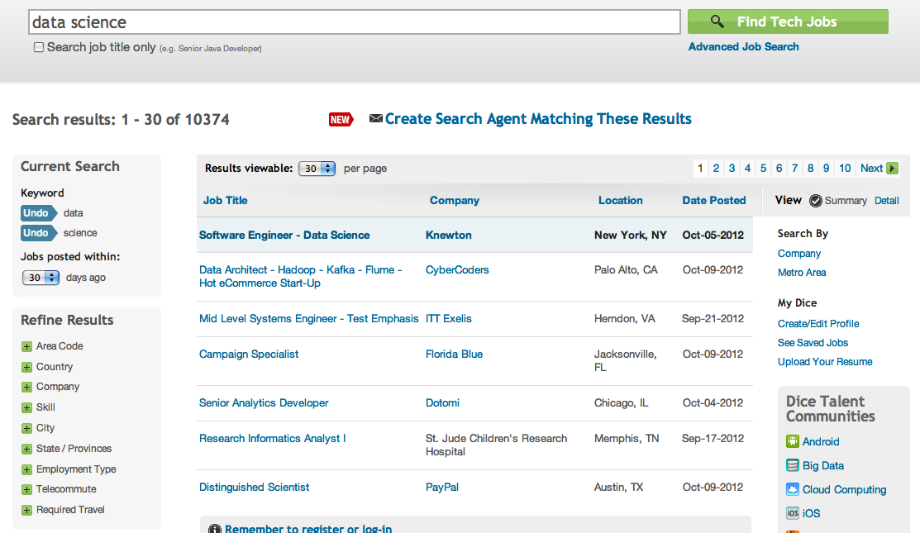
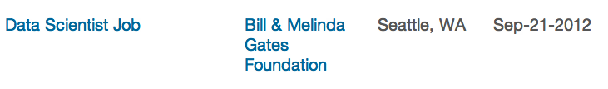
Notes:
eSciec

Slide 8
UW Data Science Education Efforts
 | Students |  |  |  | Non-Students
 | CS/Informatics |  | Non-Major |  | professionals | researchers
 | undergrads | grads | undergrads | grads
UWEO Data Science Certificate
Graduate Certificate in Big Data
CS Data Management Courses
eScience workshops
Intro to data programming
eScience Masters (planned)
Coursera Course: Intro to Data Science
Previous courses:
Scientific Data Management, Graduate CS, Summer 2006, Portland State University
Scientific Data Management, Graduate CS, Spring 2010, University of Washington

Slide 9
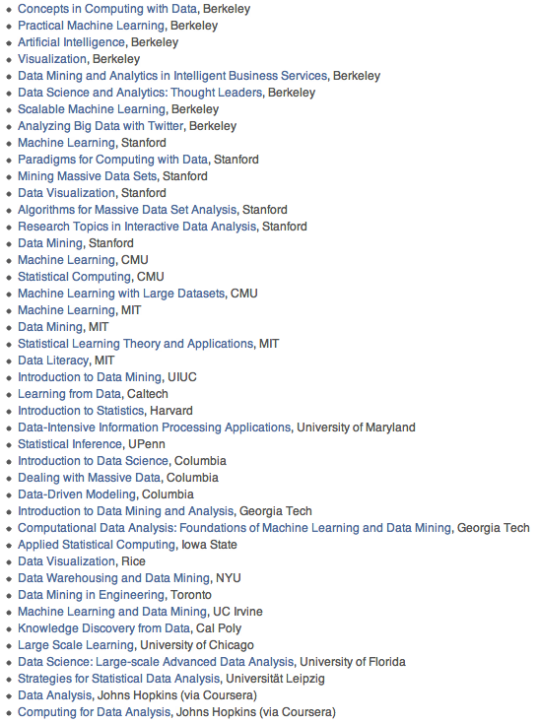
Huge number of relevant courses, new and existing.

Slide 10
“I worry that the Data Scientist role is like the mythical “webmaster” of the 90s: master of all trades.”
-- Aaron Kimball, CTO Wibidata

Slide 11
tools abstractions
Breadth
Hadoop
PostgreSQL
glm(…) in R
Tableau
MapReduce
Relational Algebra
Logistic Regression
InfoVis
Notes:
R data frames or matrices?
Hadoop or MapReduce?
Greenplum or Relational Algebra?

Slide 12
structures statistics
Depth
Management
Relational Algebra
Standards
Analysis
Linear Algebra
ad hoc files
Notes:
How much statistical sophistcation do you emphasize?
Select, project, join
slicing and dicing tables
key value stores
vs
Linear algebra
EM
Gradient descent
Statistical pattern recognition
Unsupervised learning

Slide 13
desktop cloud
Scale
main memory
R
local files
distributed
Hadoop
S3, Azure Storage
Notes:
Using R to analyze survey results
Using Hadoop to analyze clickstream

Slide 14
hackers analysts
Target
Assume proficiency in Python, Java, R
Assume little or no programming
Notes:
How much programming background do you assume? How much do you teach?

Slide 15
Breadth
tools
abstr.
Depth
structs
stats
Scale
desk
cloud
Target
hackers
analysts

Slide 16
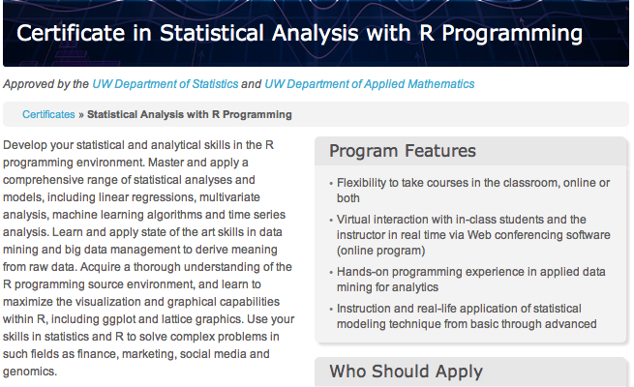
tools
abstr.
structs
stats
desk
cloud
hackers
analysts

Slide 17


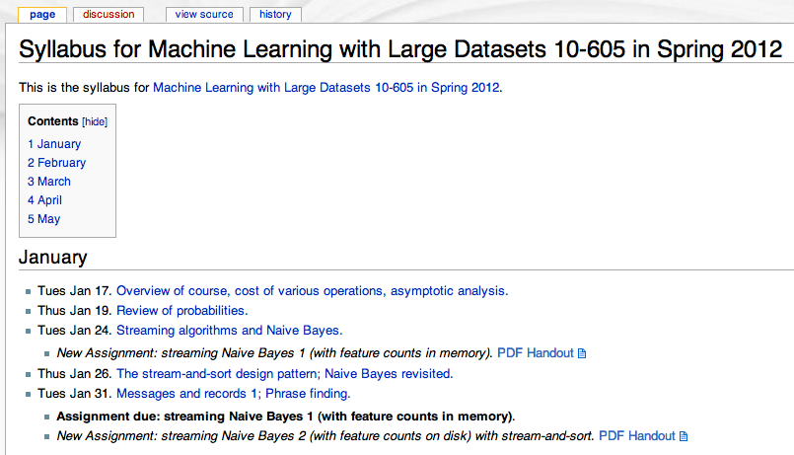
William W. Cohen
Machine Learning
tools
abstr.
tools
abstr.
structs
stats
structs
stats
desk
cloud
desk
cloud
hackers
analysts
hackers
analysts

Slide 18


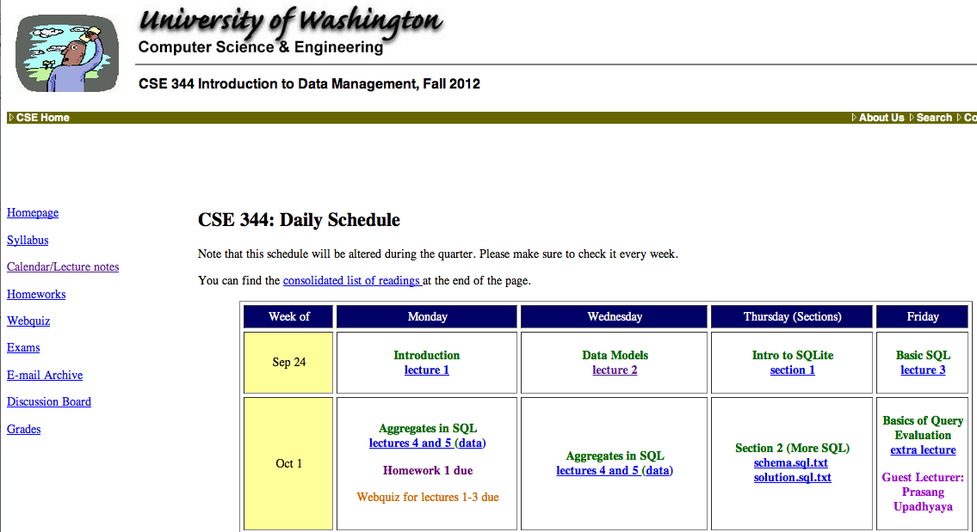
Dan Suciu
Magda Balazinska
tools
abstr.
CSE 344 Introduction to Data Management
structs
stats
desk
cloud
hackers
analysts

Slide 19
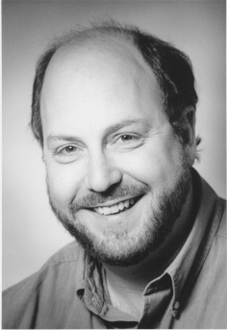
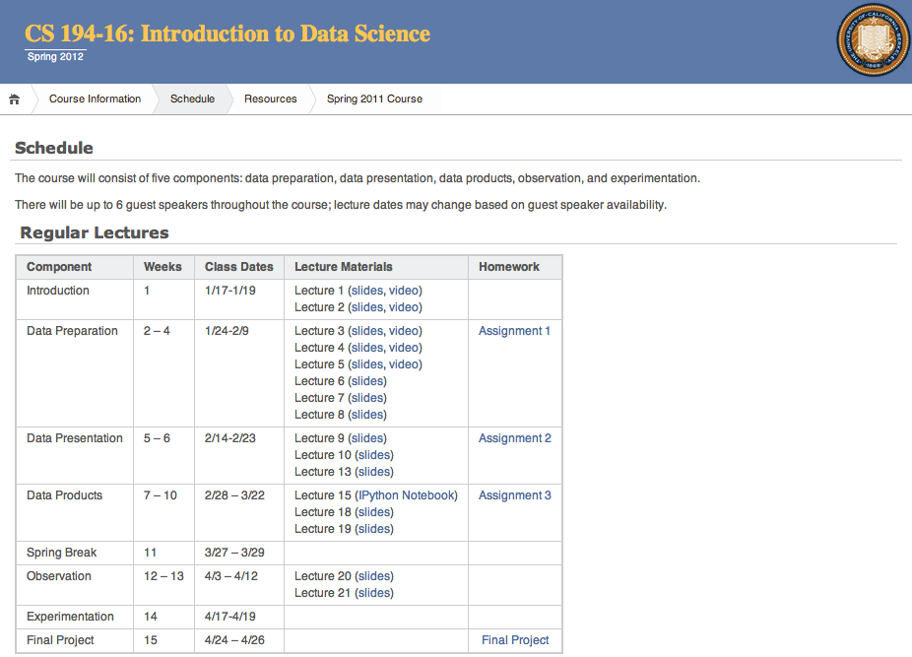
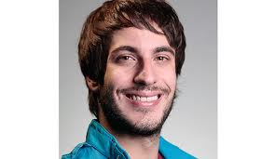
Jeff Hammerbacher
Mike Franklin
tools
abstr.
structs
stats
desk
cloud
hackers
analysts

Slide 20


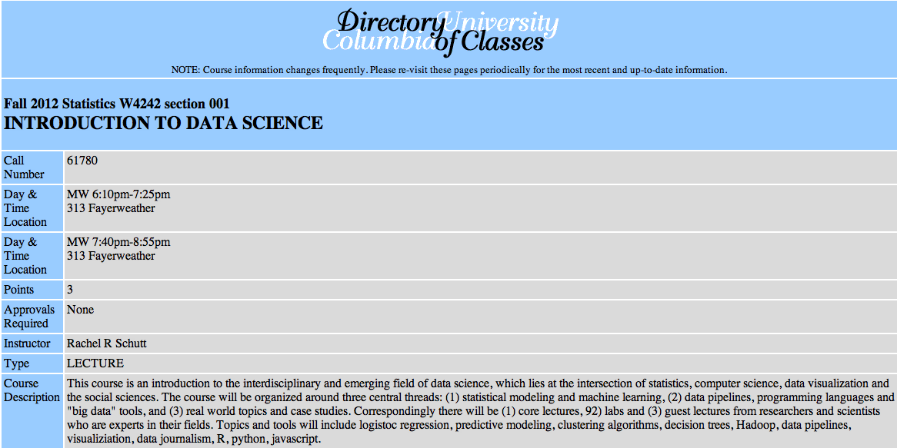
Introduction to Data Science
Rachel Schutt
tools
abstr.
structs
stats
desk
cloud
hackers
analysts

Slide 21

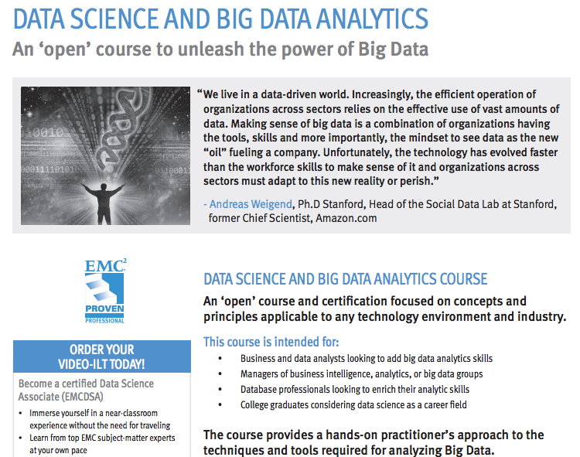
tools
abstr.
structs
stats
desk
cloud
hackers
analysts

Slide 22

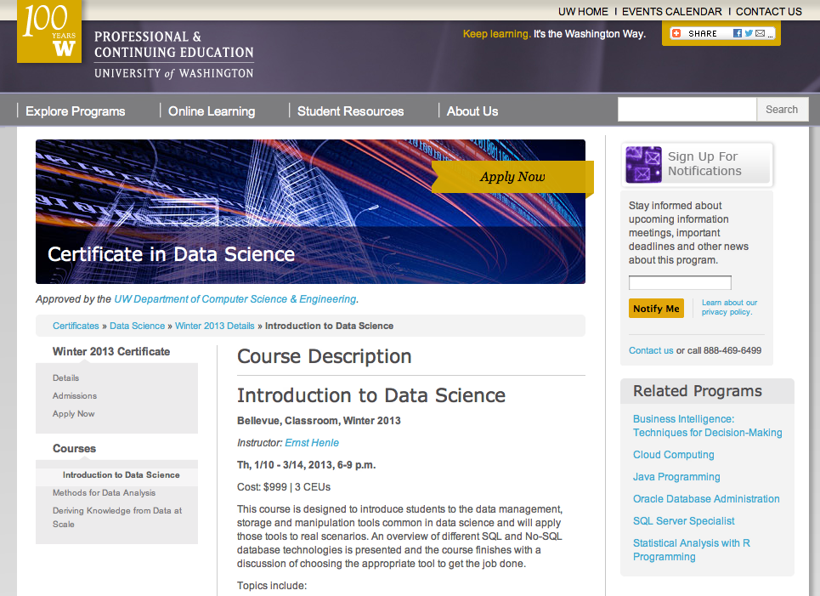
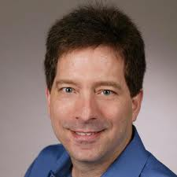
Bill Howe
Richard Sharp
Roger Barga
tools
abstr.
structs
stats
desk
cloud
hackers
analysts

Slide 23
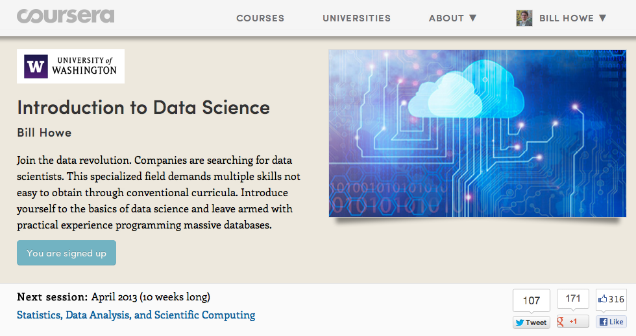
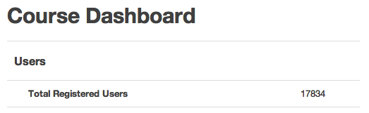
Bill Howe
tools
abstr.
structs
stats
desk
cloud
hackers
analysts

Slide 24
tools
abstr.
structs
stats
desk
cloud
hackers
analysts

Slide 25
What goes around comes around
tools
abstr.
2004 Dean et al. MapReduce
2008 Hadoop 0.17 release
2008 Olston et al. Pig: Relational Algebra on Hadoop
2008 DryadLINQ: Relational Algebra in a Hadoop-like system
2009 Thusoo et al. HIVE: SQL on Hadoop
2009 Hbase: Indexing for Hadoop
2010 Dietrich et al. Schemas and Indexing for Hadoop
2012 Transactions in HBase (plus VoltDB, other NewSQL systems)
But also some permanent contributions:
Fault tolerance
Schema-on-Read
User-defined functions that don’t suck

Slide 26
tools
abstr.
What are the abstractions of data science?
“Data Jujitsu”
“Data Wrangling”
“Data Munging”
Translation: “We have no idea what this is all about”
Notes:
“Data Jujitsu”
“Data Wrangling”
“Data Munging”

Slide 27
tools
abstr.
What are the abstractions of data science?
matrices and linear algebra?
relations and relational algebra?
objects and methods?
files and scripts?
data frames and functions?

Slide 28
structs
stats
“80% of analytics is sums and averages”
-- Aaron Kimball, wibidata
God created the integers; all else is the work of man
Codd created relations; all else is the work of man
Notes:
R and files vs. databases
Hadoop and friends vs. databases
God created …. Codd created….

Slide 29
Three types of tasks:
stats
structs
1) Preparing to run a model
2) Running the model
3) Interpreting the results
“80% of the work”
-- Aaron Kimball
Gathering, cleaning, integrating, restructuring, transforming, loading, filtering, deleting, combining, merging, verifying, extracting, shaping, massaging
The other 80% of the work

Slide 30
Problem
structs
stats
How much time do you spend “handling data” as opposed to “doing science”?
Mode answer:
“90%”
Notes:
(granted we had a minute for Bill (clearly Bill) to describe this new eScience movement)
We want to give a little background of our project before we launch into it, so we will discuss the problem we are trying to solve.
Essentially, we want to remove the speed-bump of data handling from the scientists.

Slide 31
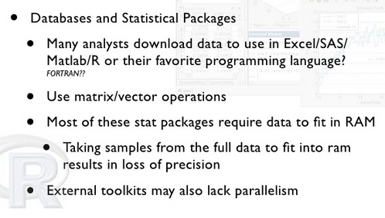
structs
stats
src: Christian Grant, MADSkills

Slide 32
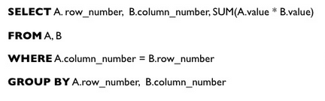
(Sparse) Matrix Multiply in SQL
structs
stats
src: Christian Grant, MADSkills
Notes:
Portable
Concise
Automatically parallelizable
Composable with cleaning, filtering, munging, etc.

Slide 33
Aside: Schema-on-Write vs. Schema-on-Read
A schema* is a shared consensus about some universe of discourse
At the frontier of research, this shared consensus does not exist, by definition
Any schema that does emerge will change frequently, by definition
Data found “in the wild” will typically not conform to any schema, by definition
But this doesn’t mean we have to live with ad hoc scripts and files
My answer: Schema-later, “lazy schemification”
* ontology/metadata standard/controlled vocabulary/etc.
Notes:
The Schema-on-read folks are winning this debate: there’s just too much heterogeity

Slide 34
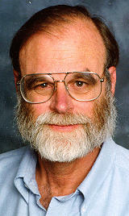
Data Access Hitting a Wall
desk
cloud
Current practice based on data download (FTP/GREP) Will not scale to the datasets of tomorrow
You can GREP 1 MB in a second
You can GREP 1 GB in a minute
You can GREP 1 TB in 2 days
You can GREP 1 PB in 3 years.
Oh!, and 1PB ~5,000 disks
At some point you need indices to limit search parallel data search and analysis
This is where databases can help
You can FTP 1 MB in 1 sec
You can FTP 1 GB / min (~1$)
… 2 days and 1K$
… 3 years and 1M$
[slide src: Jim Gray]
Notes:
Our collaborators tell us that loading data into memory with R is the major bottleneck.
It actually changes the science they can do:
I would say that we can start answering questions about macro-ecology (study of relationships between organisms and their environment at large spatial scales).

Slide 35
hackers
analysts
US faces shortage of 140,000 to 190,000 people “with deep analytical skills, as well as 1.5 million managers and analysts with the know-how to use the analysis of big data to make effective decisions.”
--Mckinsey Global Institute

Slide 36
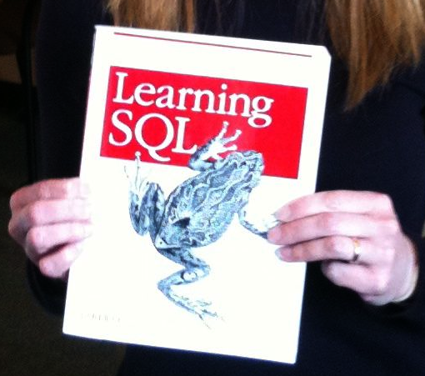
hackers
analysts
Biologists are beginning to write very complex queries (rather than relying on staff programmers)
Example: Computing the overlaps of two sets of blast results
SELECT x.strain, x.chr, x.region as snp_region, x.start_bp as snp_start_bp
, x.end_bp as snp_end_bp, w.start_bp as nc_start_bp, w.end_bp as nc_end_bp
, w.category as nc_category
, CASE WHEN (x.start_bp >= w.start_bp AND x.end_bp <= w.end_bp)
THEN x.end_bp - x.start_bp + 1
WHEN (x.start_bp <= w.start_bp AND w.start_bp <= x.end_bp)
THEN x.end_bp - w.start_bp + 1
WHEN (x.start_bp <= w.end_bp AND w.end_bp <= x.end_bp)
THEN w.end_bp - x.start_bp + 1
END AS len_overlap
FROM [koesterj@washington.edu].[hotspots_deserts.tab] x
INNER JOIN [koesterj@washington.edu].[table_noncoding_positions.tab] w
ON x.chr = w.chr
WHERE (x.start_bp >= w.start_bp AND x.end_bp <= w.end_bp)
OR (x.start_bp <= w.start_bp AND w.start_bp <= x.end_bp)
OR (x.start_bp <= w.end_bp AND w.end_bp <= x.end_bp)
ORDER BY x.strain, x.chr ASC, x.start_bp ASC
We see thousands of queries written by non-programmers

Slide 37
UW Curricular Activities
 | Students |  |  |  | Non-Students
 | CS/Informatics |  | Non-Major |  | professionals | researchers
 | undergrads | grads | undergrads | grads
UWEO Data Science Certificate
Graduate Certificate in Big Data
Database Courses
eScience workshops
Intro to data programming
eScience Masters (planned)
Coursera Course Intro to Data Science

Slide 38
How do you deliver hands-on big data experience to 10k students?
Cloud vendors’ free tiers?
1 micro instance is not “big data”
Cloud vendors’ academic discounts? (e.g., Amazon’s education grants)
$100 / head = $1M
invites abuse: free credits with no obligation to complete course
Out of pocket?
Don’t want to be the only non-free Coursera course
Unclear that we can require it (perhaps analogous to a textbook?)

Slide 39
10k Students on 10k GB for $10k
Requirements
Inexpensive: Need a fixed, small budget; O(10k) maximum
Fair: All students need to be able to complete the assignment
Non-solutions
Fixed cluster
Fairness problems; no quality of service guarantees
Autoscaling cluster
No upper bound to cost
Budget cap (via, e.g., Amazon’s IAM)
Fairness problems: Different students consume different levels of resources depending on background, etc.

Slide 40
10k Students on 10k GB for $10k
Key idea: 10k students all working on the same assignment = lots of redundancy
Students debug locally on scaled down datasets
Then submit 10k jobs
Prune the queue aggressively
Remove duplicates
Detect typical mistakes syntactically; return cached results
Global common subexpression elimination (feasible thanks to abstractions)

Slide 41
10k Students on 10k GB for $10k
Another approach we are considering: Kaggle-Kaggle-style Prize assignments
student | date | runtime | output | quality | notes | votes
sarah123 | 4/23/12 | 5 min 44 sec | result.txt | 45% | I removed the dirty data for this run | 456
jane456 | 4/22/12 | 3 min 23 sec | result.txt | 23% | I used gradient descent this time | 97
:
:
Pay-to-play: Students submit successful jobs to access leaderboards
Cast votes for their preferred solution.
Grade determined by
f(votes(your_solution), grade(your_solution), grade(solutions_you_voted_for))
We run the top-k highest ranked solutions on the full size dataset
Problem: Easy to game the system and just coast

Slide 42
http://escience.washington.edu
billhowe@cs.washington.edu
Coursera course:
https://www.coursera.org/course/datasci
Certificate program:
http://www.pce.uw.edu/courses/data-science-intro

Slide 43
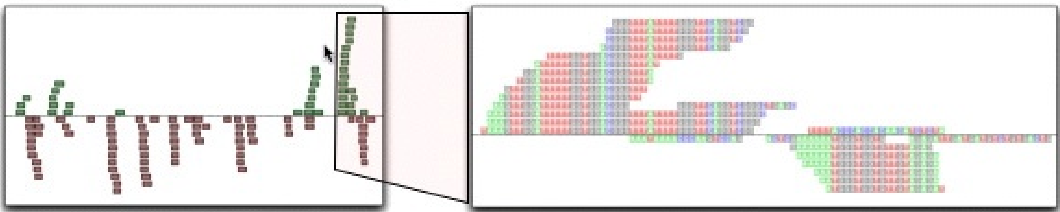
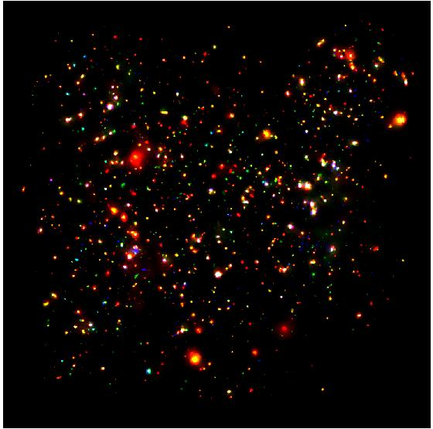
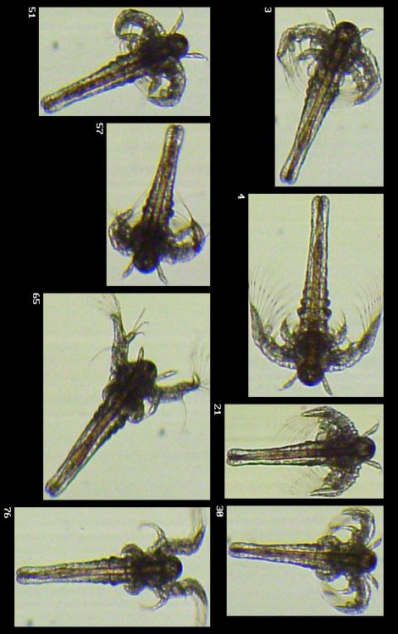
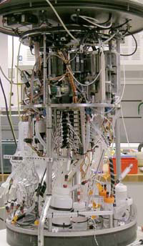
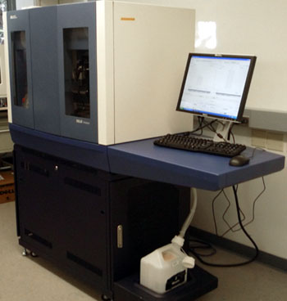

Science is becoming a database query problem
Old model: “Query the world” (Data acquisition coupled to a specific hypothesis)
New model: “Download the world” (Data acquisition supports many hypotheses)
Astronomy: High-resolution, high-frequency sky surveys (SDSS, LSST, PanSTARRS)
Biology: lab automation, high-throughput sequencing,
Oceanography: high-resolution models, cheap sensors, satellites
40TB / 2 nights
1 device
~1TB / day
100s of devices
Notes:
Drowning in data; starving for information
We’re at war with these engineering companies. FlowCAM is bragging about the amount of data they can spray out of their device. How to use this enormous data stream to answer scientific questions is someone else’s problem.
“Typical large pharmas today are generating 20 terabytes of data daily. That’s probably going up to 100 terabytes per day in the next year or so.”
“tens of terabytes of data per day” -- genome center at Washignton University
Increase data collection exponentially with flowcam

Slide 44
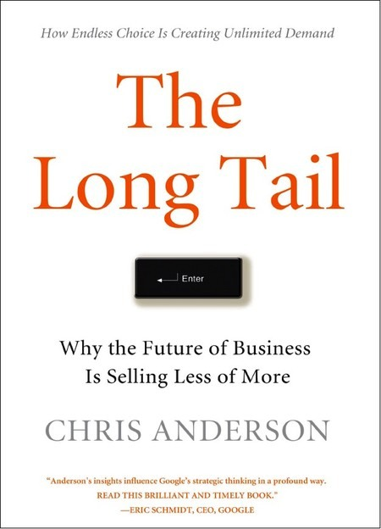
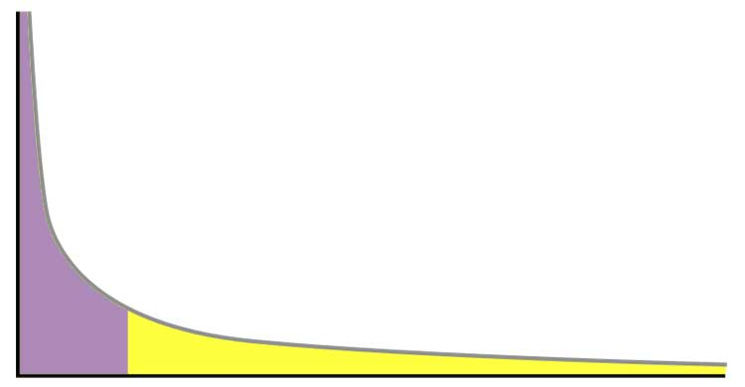
[src: Carol Goble]
Power distribution
80:20 rule
Head
Popularity / Sales
Tail
Products / Results
First published May 2007, Wired Magazine article 2004
Notes:
80:20 rule
Power laws
The Long Tail or long tail refers to the statistical property that a larger share of population rests within the tail of a probability distribution than observed under a 'normal' or Gaussian distribution.
Small Science
New Science
Open Science
Distributed Science
Niche Science

Slide 45
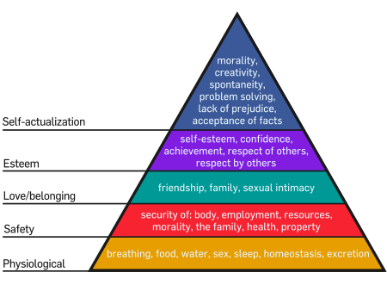
A “Needs Hierarchy” of Science Data Management
“As each need is satisfied, the next higher level in the hierarchy dominates conscious functioning.”
-- Maslow 43
full semantic integration
analytics
query
sharing
storage
Notes:
But the fundamental error made by computer scientists, and it’s probably the fault of the database community, is to assume that semantic integration is a prerequisite for query and analytics.
It isn’t. It’s the final goal, not some insignificant preamble to analysis.
Domain scientists know this – they take a very pragmatic approach. They write code to do data handling, they write code to do analytics, and they do data integration on the fly in a task-specific way.
So one of my goals is to convince you of is that you can decouple declarative query from semantic integration, and doing so gives scientists a very powerful tool.

